Slide 1
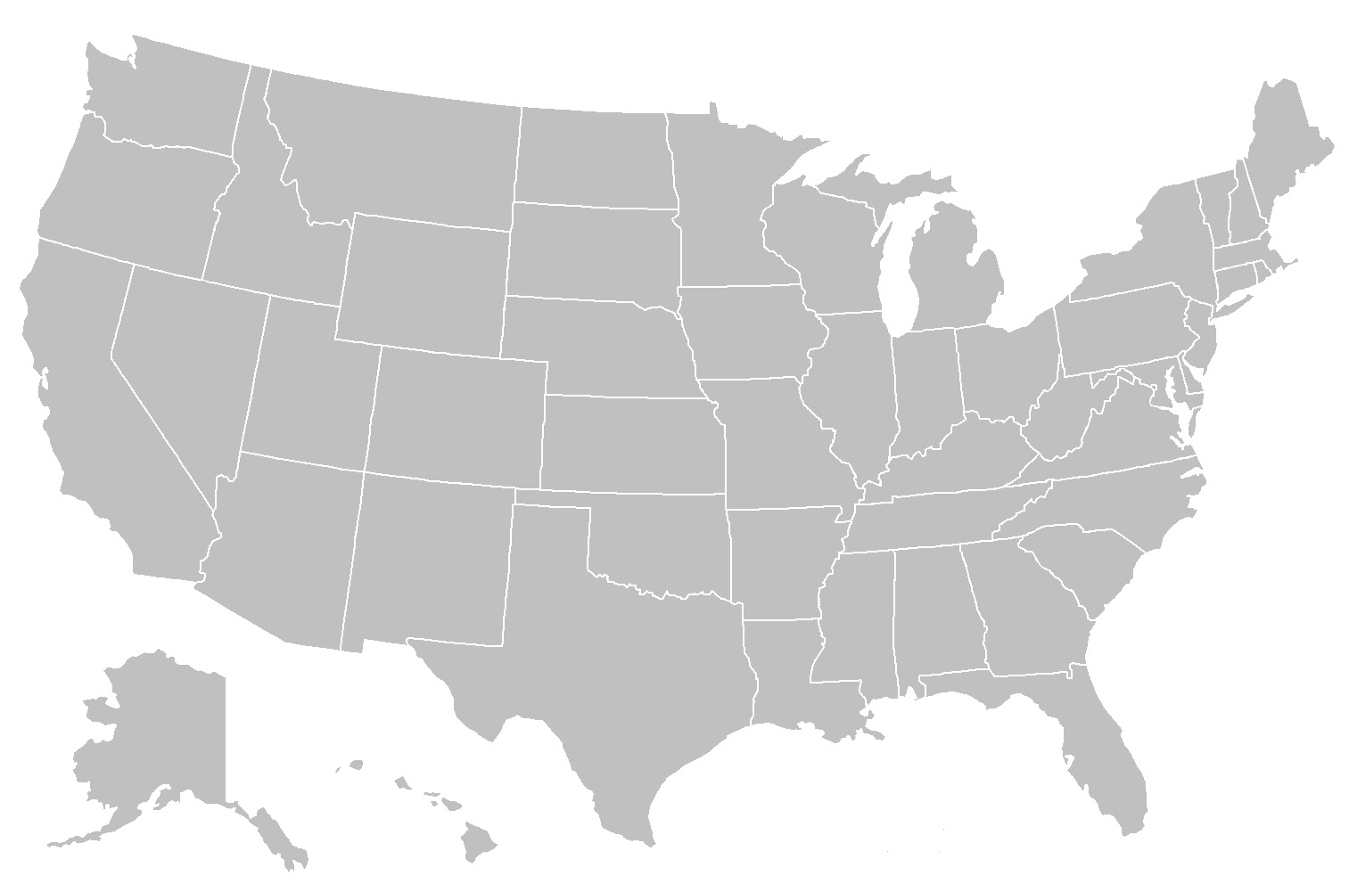
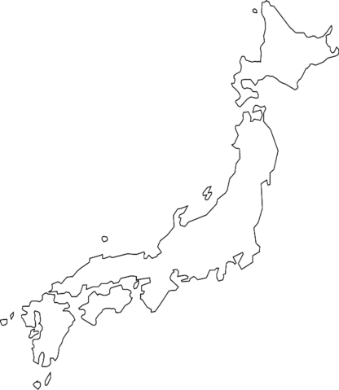
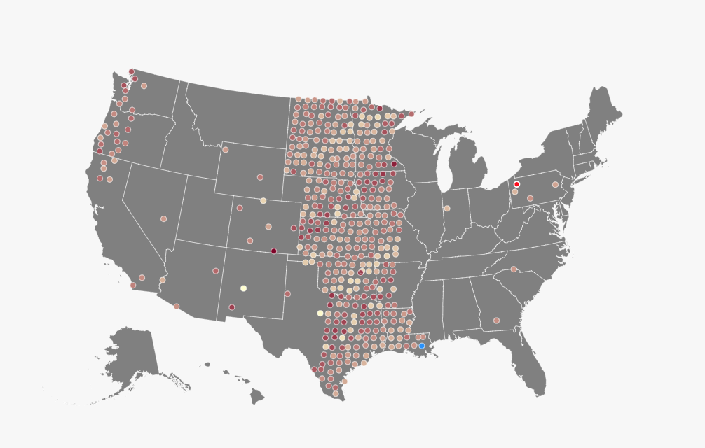
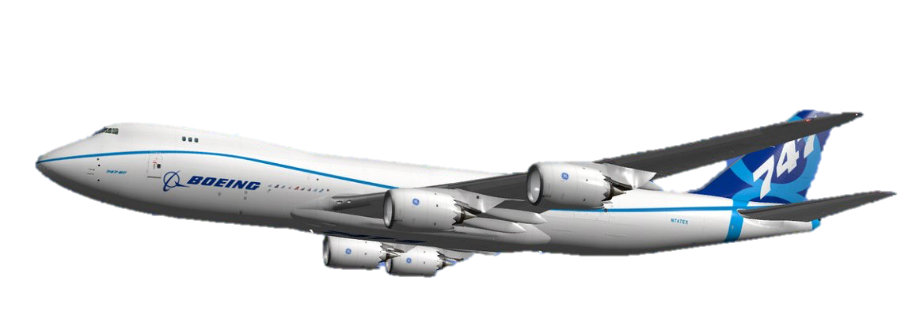
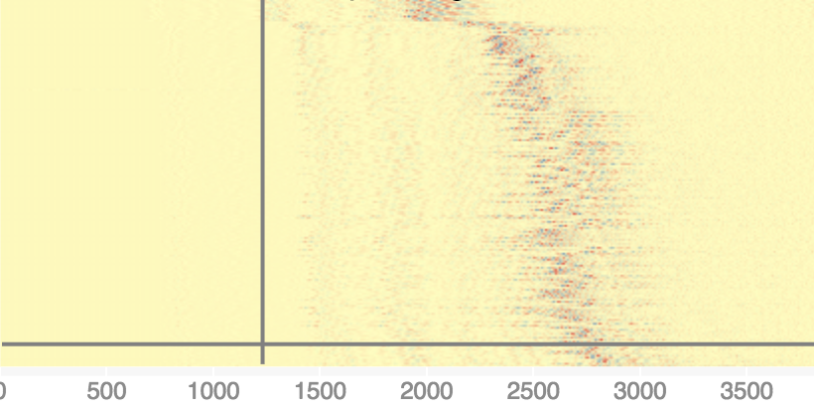
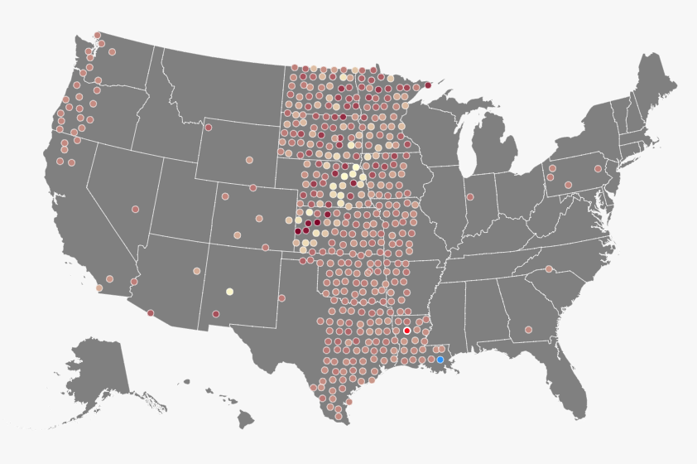
2011
Tōhoku Earthquake
How fast does earthquake travel?
P waves: ~21600-50400 km/hr
S waves: ~14400–21600 km/hr
Boeing 747: ~920 km/hr
Date: March 11, 2011
Large amount of energy build up
–6 mins
Tension build up for a Geology Conference in Toronto
The pacific plate is sliding underneath the continental plate of Japan and building up a tremendous amount of energy.
Tōhoku quake begins
00:00:00
Takes off from Chicago
The earthquake begins on local time 14:46:24. The subduction zone releases tremendous amount of energy and was recorded as a magnitude 9.1, the largest in Japanese history.
5 mins
The earthquake lasted 6 minutes
Looking out the window and see some clouds
The earthquake caused one of the largest tsunami and history. The amount of energy released by the quake can power the entire City of Los Angeles for an year.
Waves travel across the world
10 mins
Earthquake creates two different form of waves, p waves and the s wave. P waves is caused by compression of the earth and S waves is the shear motion. It travels through the earth’s surface, mantle, and the core.
http://www.earthobservatory.sg/news/great-east-japan-tohoku-2011-earthquake-important-lessons-old-dirt
15 mins
P waves reaches the U.S.
Reaching cruising altitude of 35,000 feet
After about 18 minutes, transportable arrays in the U.S. recorded the Primary waves..
S waves hit the U.S
30 mins
Somewhere over Detroit….
30 minutes after the quake, transportable arrays in the U.S. recorded the Secondary waves..
Earthquake travels really fast and most of the time they are very destructive…
Created by: Edmond Lai, Ta-Yeo Lee, Wenhan Kong, Yuwei Chen

